Slide 1






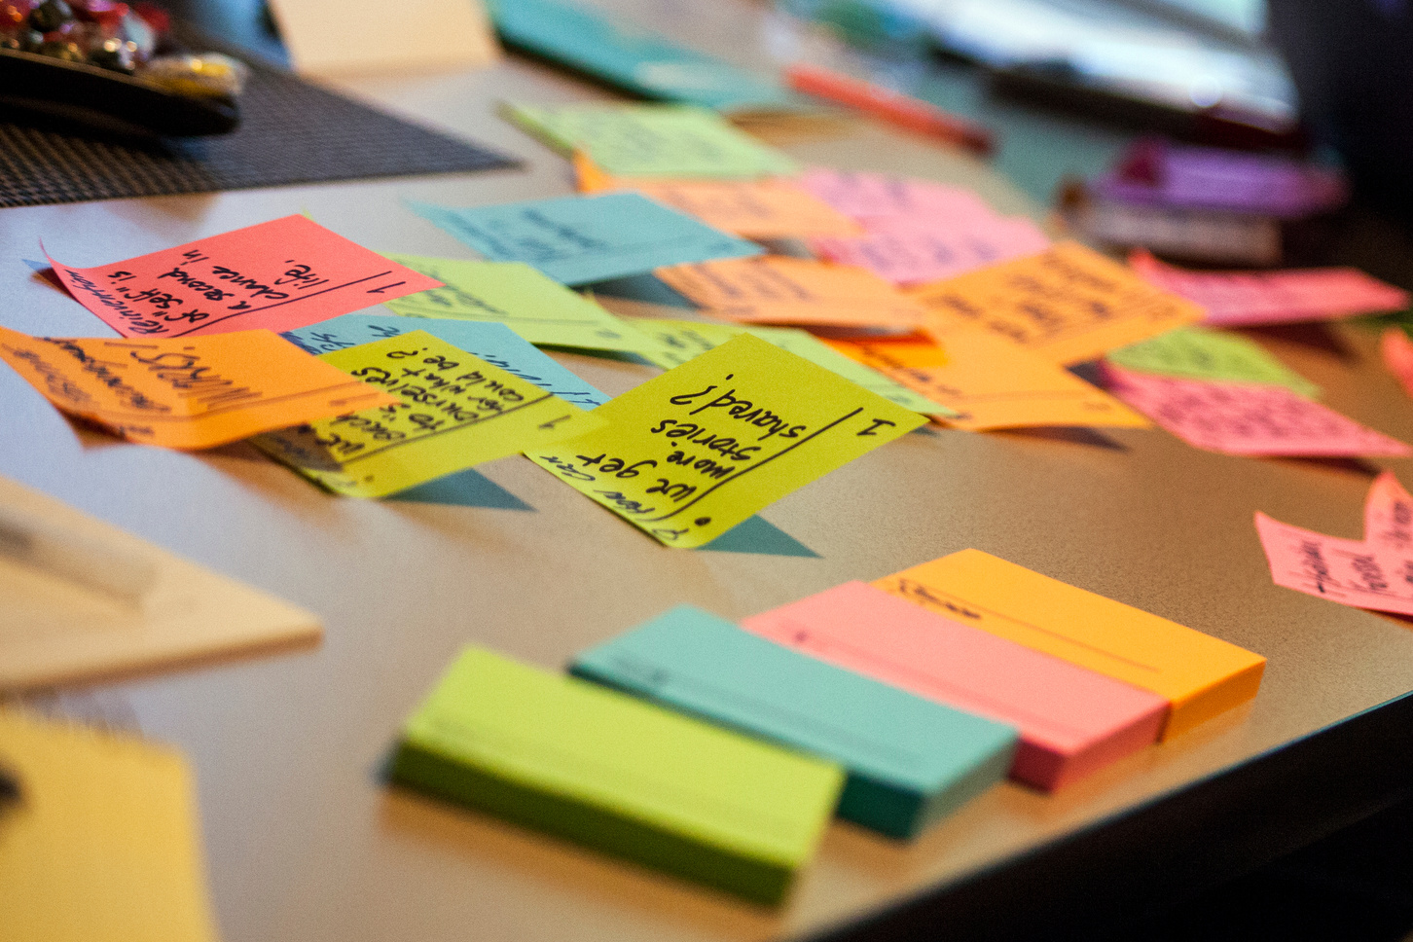


CROP-LENS
PLANT DISEASE DETECTOR
PRESENTATION 2026
Student Name
Student Email
Guide
Grace Theresa
Gilla Lasya Priya
Ankitha Sarwady
Devya Vutpala
gracetheresa38@gmail.com
gillalasyapriya@gmail.com
sarwadyankitha@gmail.com
devya.vutpala@gmail.com
Mr. Thribhuvan Reddy Mandhadi

Slide 2

OUTLINE
Abstract of the Project
Problem Statement
Proposed Solution
System Architecture
Live Demo of the Project
Embedded Video of Project
Conclusion
Future Scope

Slide 3
Abstract
Crop diseases are a major cause of yield loss, and many farmers lack quick access to experts who can identify them early.
CropLens is a responsive web platform that aims to help growers check crop health from a leaf photograph.
A user selects a crop, uploads an image and receives a readable summary of the likely disease, its severity, its symptoms and general management and prevention guidance.
The platform also provides a searchable disease library, scan history, a statistics dashboard and user profile management.
The current prototype implements the complete user interface in React, Vite and Tailwind CSS using clearly labelled sample data.
The AI inference and backend services are designed as the next phase.
The aim is to make early crop disease awareness accessible, understandable and mobile-friendly.

Slide 4

Problem Statement
Farmers often identify crop diseases late, or incorrectly, because:Many diseases show similar leaf symptoms, which makes manual identification difficult.
Agricultural experts and extension services can be slow or hard to reach, especially in rural areas.
Information is scattered, often technical, and rarely tied to a specific crop.
Late or wrong action leads to reduced yield, higher input costs and avoidable crop loss.
There is a need for an easy-to-use, crop-aware tool that turns a simple photograph into clear, understandable guidance, while being honest about its limits and directing users to experts for confirmation.

Slide 5
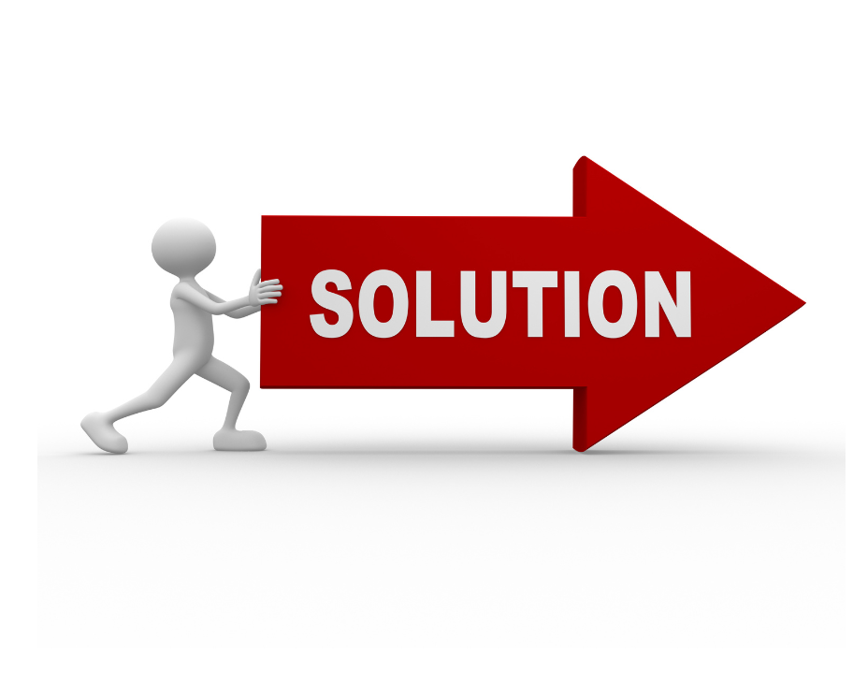
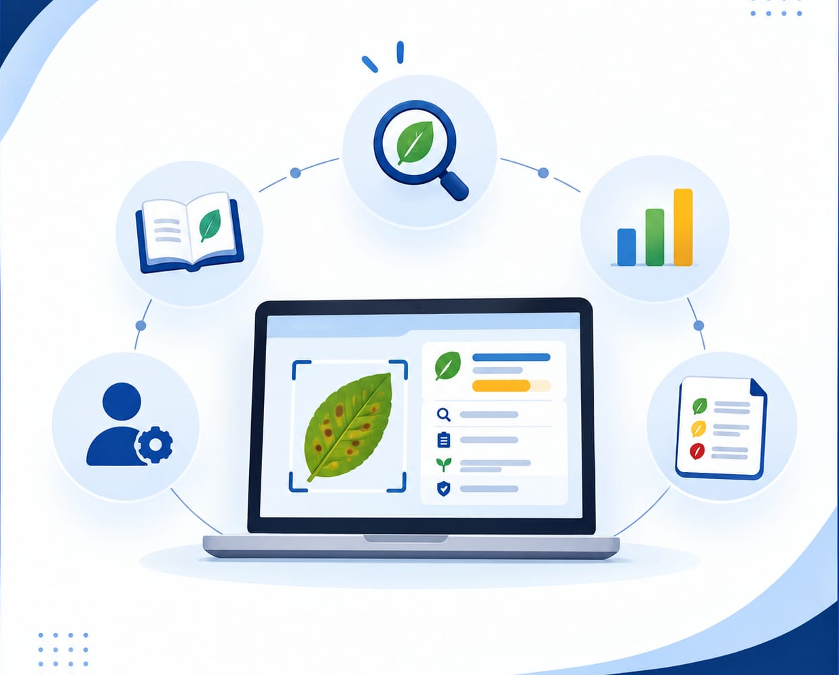
Proposed Solution
CropLens provides a web application with these parts:
Detection flow: the user picks a crop, uploads or captures a leaf photo and sees a preview. The result view shows the disease name, type, severity, symptoms, management and prevention.
Disease library: a searchable, filterable reference by crop, disease type and severity, with detailed entries.
Dashboard and history: scan statistics, recent activity and a searchable record of past scans.
Accounts and profile: signup, login and profile preferences such as primary crops.
Responsible design: demo results are labelled as sample data and never presented as real predictions. Guidance is general, with no dosages or product claims, and it points users to local agricultural experts.
Current status: the frontend is complete with local sample data.
Planned phases: a trained image-classification model, a backend inference API, real authentication and cloud storage.

Slide 6
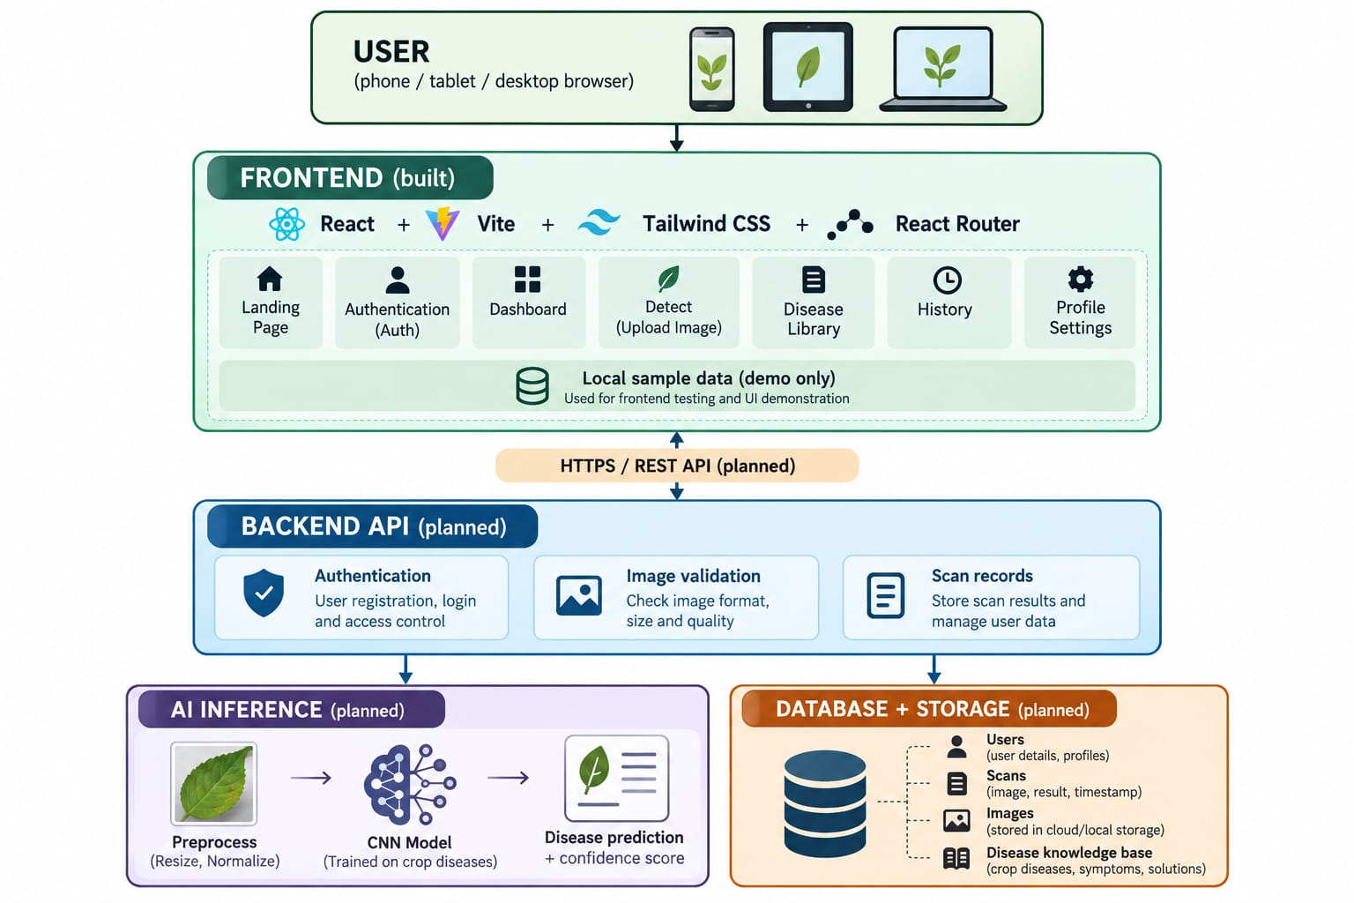
System Architecture
Data collection: gather labelled leaf images (e.g. the PlantVillage dataset).
Preprocessing: resize, normalise and augment the images, then split into train, validation and test sets.
Modeling: train an image classifier to detect crop diseases.
Evaluation: test on unseen images using accuracy, precision, recall and F1-sco
Integration: connect the model to the website through an API
Deployment: host the app so users can use it on any device,
Models: a CNN using transfer learning (MobileNetV2 or ResNet50).
Tools: Python, TensorFlow/ Keras, OpenCV. FastAP], React, Vite, Tailwind CSS, Git

Slide 7

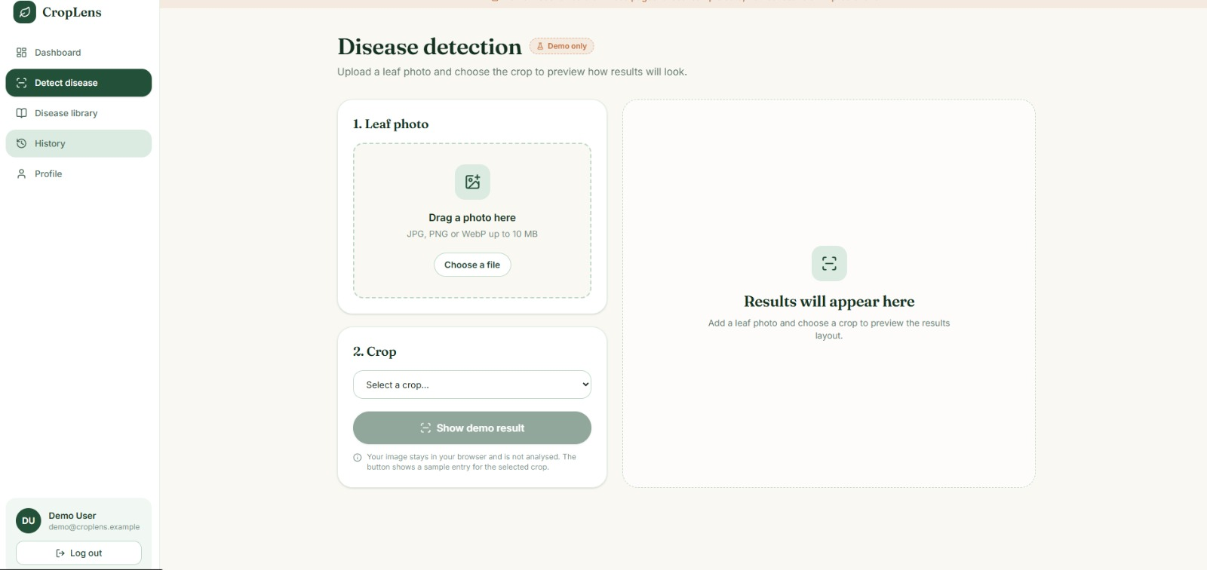
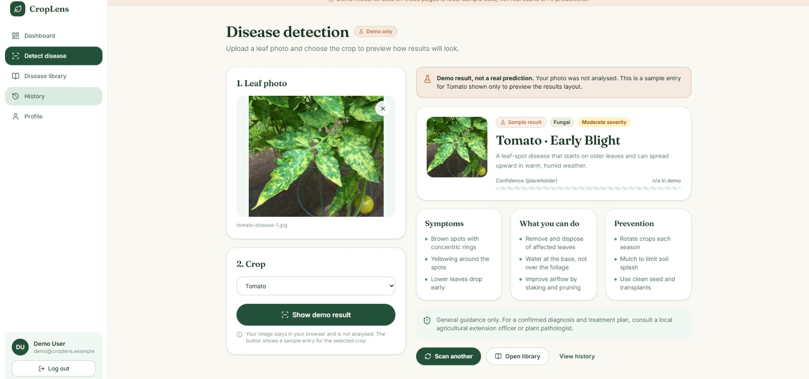
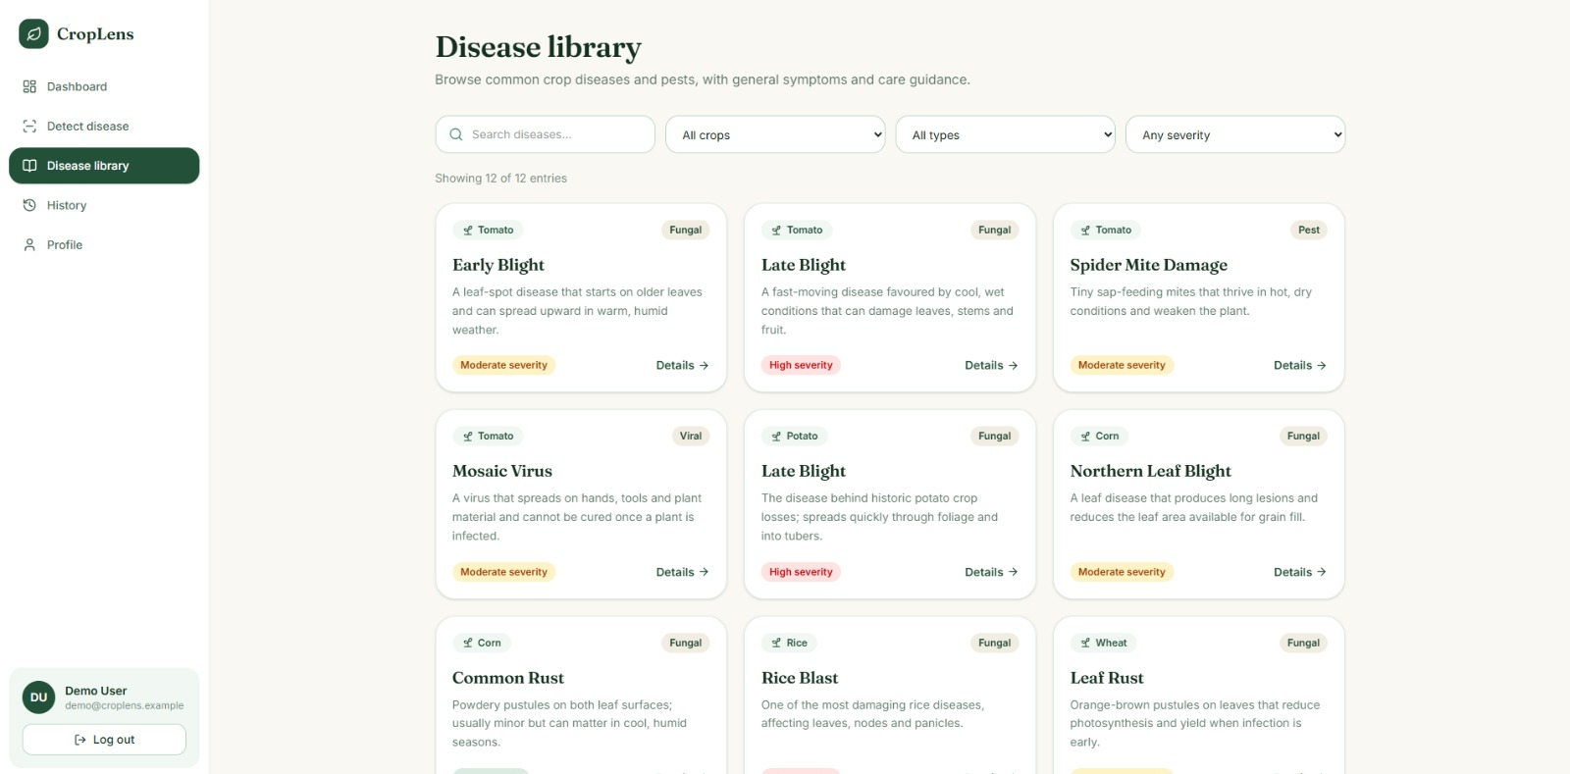
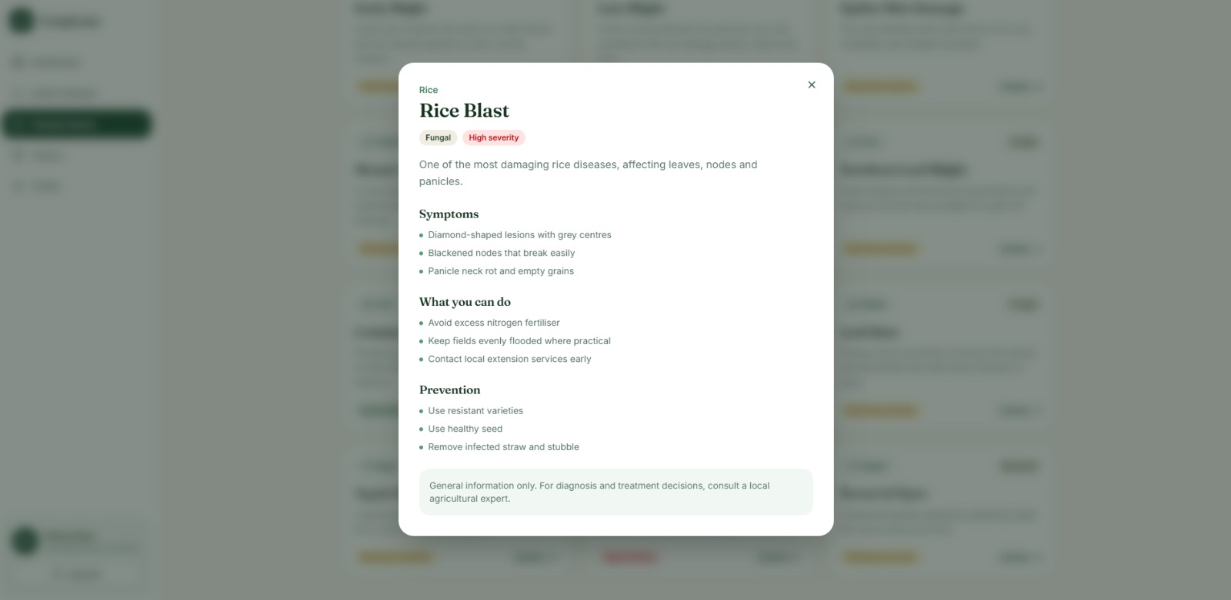
Demo of Project
Demo Link: https://instant-azure-mu0yhbl.tmp.now/

Slide 8
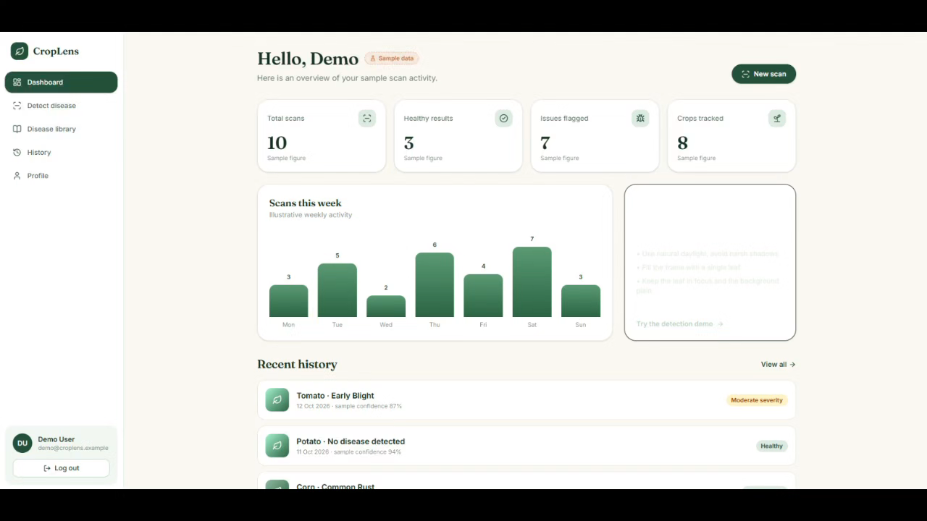
Video of Project Demo

Slide 9

Conclusion
CropLens shows how a plain photo of a leaf can turn into clear, useful advice for a farmer. The prototype covers the whole journey, from choosing a crop and uploading a photo to reading the result and checking past scans. It works well on both phones and computers. The data is sample data for now, and the results are not real predictions. We did this on purpose so the design could be tested properly before adding the AI. The interface is ready to connect to a trained model, so this is a solid base for building a real early-warning tool for crop health.

Slide 10

Future Scope
AI model integration
Train or fine-tune an image-classification model on a public dataset such as PlantVillage.
Accuracy and real-world testing
Test with real field photos, which differ from clean dataset images in lighting and background..
Accessibility for farmers
Support regional languages.
Smarter guidance
Add location and season-aware tips, and weather-linked disease risk alerts.
Platform growth
Build a mobile app with direct camera capture.
Add an expert or community feedback loop to improve the model over time.

Slide 11
Thank You
Notes:
thank you very much for joining this PPT, keep learning.
11

